Slide 1
CAD Design Part 1
AE460
Greg Marien
Lecturer

Slide 2
Background/Purpose
CAD is the tool of choice for modern design activity, providing:
Accuracy of the design
Ease of collaboration in the design and manufacturing of a product
Ease of changes in the design
This activity assumes
You have had a course in SolidWorks and a working knowledge of the tool
You will take pity on me since I only know Pro/E, CATIA, and NX
Purpose:
Set you up with a working knowledge of the “rules” to designing complex assembly
Assist to get you started laying out your configuration
Standardization is key to maximizing the efficiency of using CAD tools.

Slide 3
Standardization
Create a Part Template and Assembly Template in the proper coordinate system orientation
Use the Aircraft Coordinate System (ACS) method for design
Use ACS for every part to ensure proper coordinate system
Create the Loft Surfaces of the aircraft and “lock it down” from any changes ASAP
Loft surfaces are also known as Outer Mold Line (OML)
Use Loft Surfaces to create Layouts of:
Primary Structure (load path)
Control Surfaces
Subsystems
Landing Gear, Cockpit, Passenger compartment, Fuel Volumes/Tanks, LRUs, Payloads, etc.
Make models as parametric as possible (I will show you how)
The Layout is then used in design discussions for:
Configuration Design during conceptual and preliminary design phases
Design fesibility - Does it address all the requirements?
Weight and Mass Balance Analysis
Lift, Drag, Performance Analysis
Cost Analysis
Trade Studies
Comparisions of existing or competing aircraft
Use General Arrangement and Inboard Profile drawings to foster real-time design discussions in your teams

Slide 4
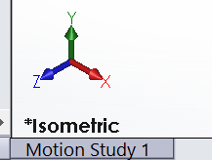
Part/Assembly Template for SolidWorks
Use STARTPART.SLDPRT and STARTASSY.SLDASM downloaded from class website
Open the file in SW and do a SAVE AS, then “Save as type”.prtdot and .asmdot for part and assemblies, respectively. This allows you to have the template available when doing file->new.
Why do this?
Note the Default Global Coordinate System has Z axis on the horizontal plane. Also notice standard names for the planes: Front, Top and Right.
This is not an aircraft design convention, therefore use the template I provide.
Default
Requried

Slide 5
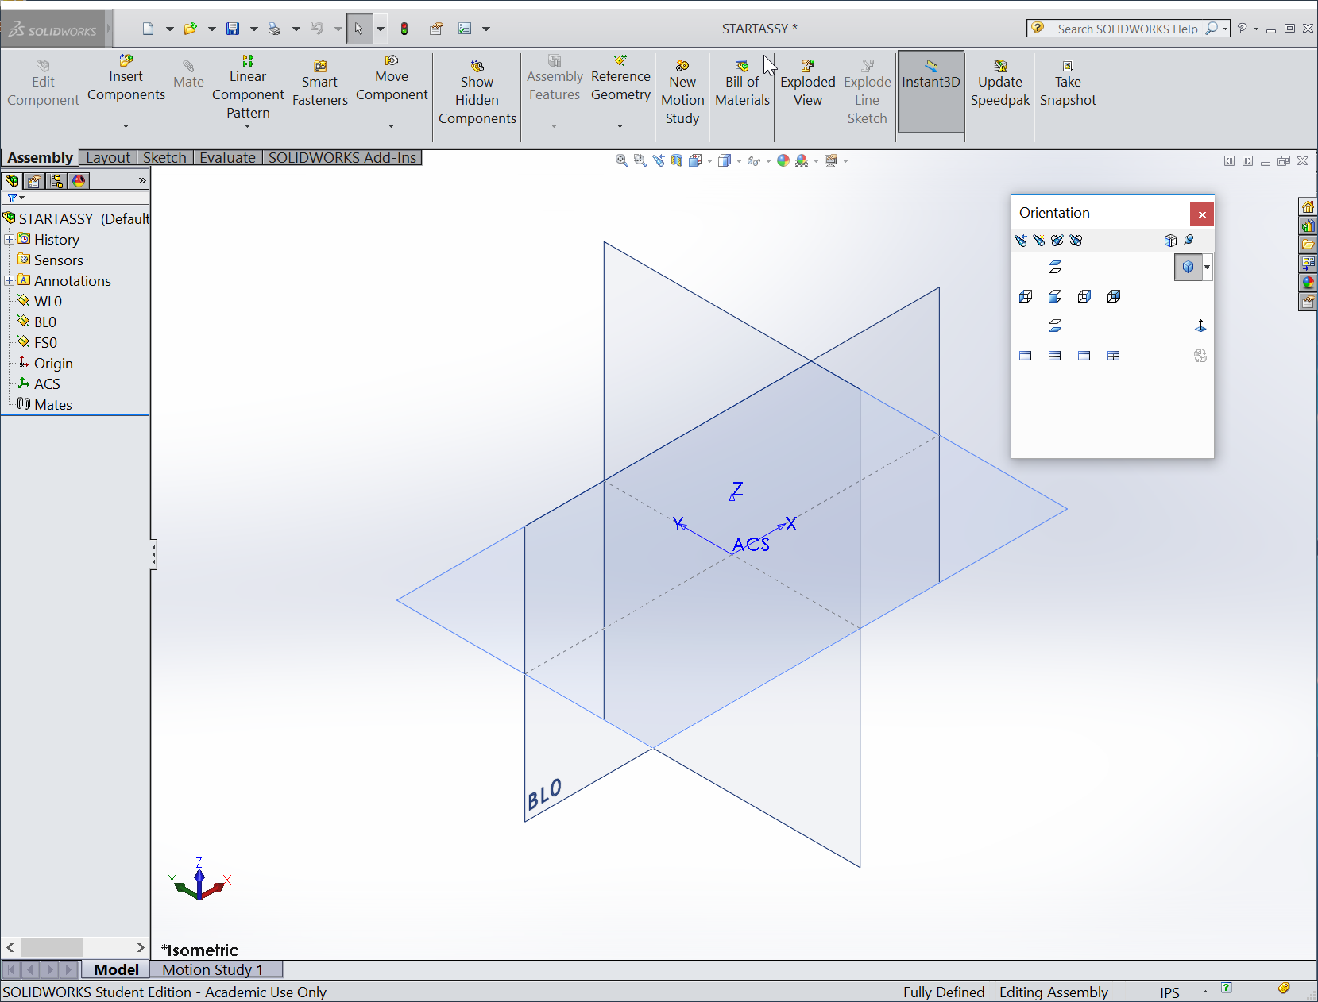
Example

Slide 6
Backup

Slide 7
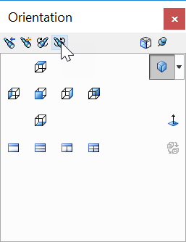
Creating a “STARTPART” template
Create a new part
In the isometric view, note the Z axis is in the horizontal plane (TOP Plane)
Press the spacebar, bringing up the Orientation window then “Pin” Orientation pallet, just for ease of use.
Click on FRONT view, making it normal and pointing to you.
In the Orientation window click on Update Standard Views
In the Orientation window click on the Top View
You will receive a warning about the change, click Yes
Click on Iso-view, which now shows the correct orientation
Rename plane names to Water Line, Frame/Fuselage Station and Butt Line “zeros” as follows:
Front Plane to WL0
Top Plane to FS0
Right Plane to BL0
Add a Coordinate System (CS) to the part and rename the CS to “ACS” (May need to “Rebuild” to have the name show up properly)
Save part as a Part Template: call it STARTPART
Use the STARTPART for all your parts that are to be in one location only, i.e. loft, primary structural parts and control surface parts. Payloads, LRUs, etc, may be modeled at 0, 0, 0 and assembled into ACS.
“STARTASSY” was also created in this way

