Slide 1
CAD Design
Part 2
AE460
Greg Marien
Lecturer

Slide 2
Background
Ship design history
Surfaces with CAD
  Lofting method is independant of CAD system (Solidworks, Creo, NX, etc.)
  Loft is also know as the Outer Mold Line (OML)
  Innner Mold Line (IML) is the OML minus the thickness of the skin
  Loft is the anchor and form factor of the primary structure, i.e skins, frames bulkheads, spars, ribs, stringers, longerons, etc.
Lofting uses a combination of:
  Conics,
  Splines,
  Spines,
  Swepted Blends Surfaces,
  Multi-Section Surfaces
Warning: Lofting is an art, and coordination with aero is required to get the smoothness and accuracy for the loft.

Slide 3
Standardization
Create a Part Template and Assembly Template in the proper coordinate system orientation
  Use the Aircraft Coordinate System (ACS) method for design
  Use ACS for every part to ensure proper coordinate system
Create the Loft Surfaces of the aircraft and “lock it down” from any changes ASAP
  Loft surfaces are also known as Outer Mold Line (OML)
Use Loft Surfaces to create Layouts of:
  Primary Structure (load path)
  Control Surfaces
  Subsystems
    Landing Gear, Cockpit, Passenger compartment, Fuel Volumes/Tanks, LRUs, Payloads, etc.
  Make models as parametric as possible (I will show you how)
The Layout is then used in design discussions for:
  Configuration Design during conceptual and preliminary design phases
  Design fesibility - Does it address all the requirements?
  Weight and Mass Balance Analysis
  Lift, Drag, Performance Analysis
  Cost Analysis
  Trade Studies
  Comparisions of existing or competing aircraft
Use General Arrangement and Inboard Profile drawings to foster real-time design discussions in your teams

Slide 4
Where to Begin?
Start with knowns
  Wing Planform
  Tail planform (Vertical and Horiztonal)
  Airfoils
  Payloads
  Avionics
  Radar
  Engines
  Fuel volume
  Landing Gear/Tire sizing
  Tip back criteria
Create a scale planform and side views sketch and create a “lofting plan”
  Use Reference Aircraft Coordinate System (ACS) (0, 0, 0)
  Ensure every “known” from above fits
Obtain approximate x, y, z (FS, BL, WL) locations from the lofting plan then go to town!
  Result is the first 3-view
FS = Frame or Fuselage Station
BL = Butt Line
WL = Water Line

Slide 5
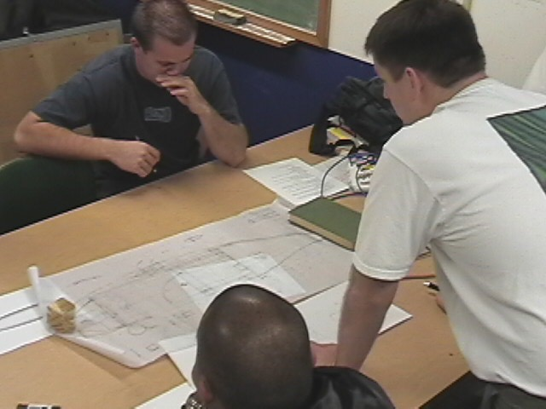
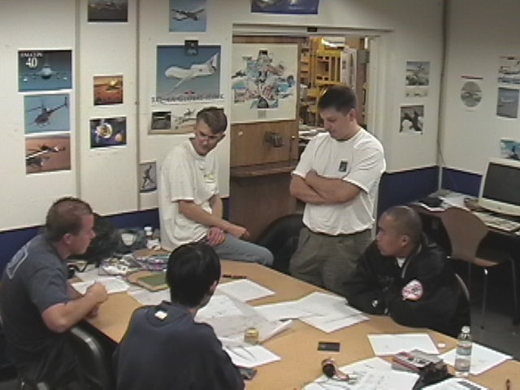
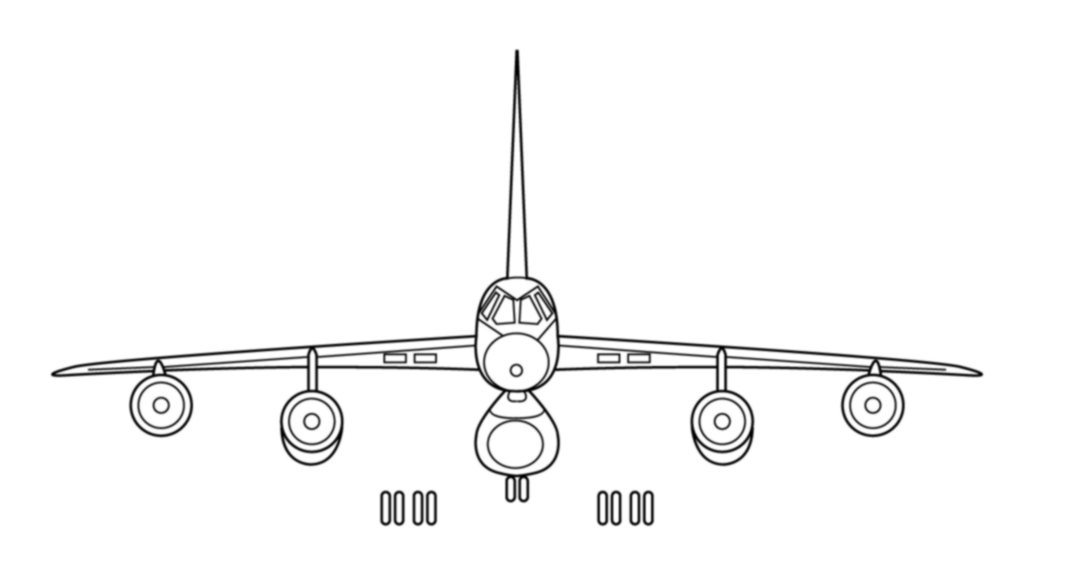
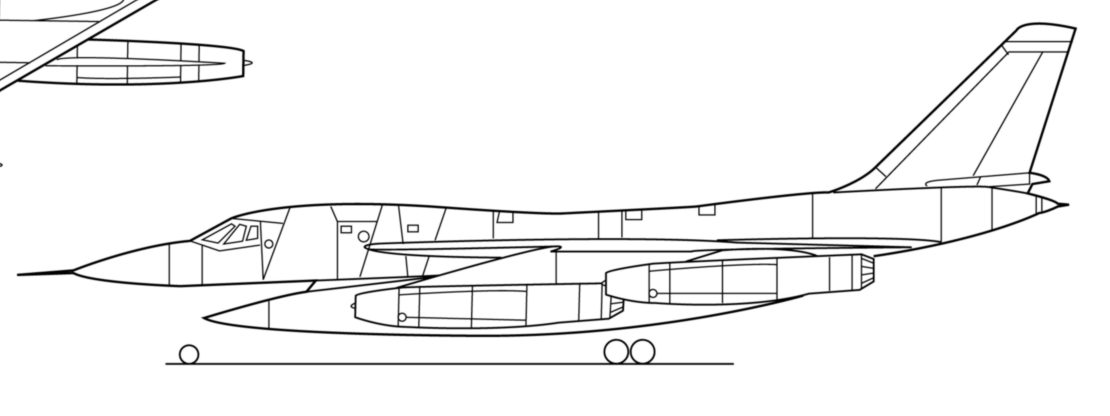
Scale Sketch
Sketch in ACS
Obtain X, Y, Z Locations for loft
Don’t forget to account for all payloads and systems in the sizing!
Submit Sketch(s) for Approval
Y
X
Z
Z
Y
X
0,0,0
ACS

Slide 6
Wing Loft

Slide 7
Wing Layout
LE Sweep
Apex (x, y, z)
Inputs
  Planform
    Wing Apex Location (x, y, z)
    Tip and Root Chords
    Span
    LE Sweep
  Other
    Dihedral
    Incidence Angle
    Twist (wash-out, wash-in)
    Airfoil Choices
Outputs
  Wing Loft
c_{r}
c_{t}
b

Slide 8
Wing Loft
TBD

Slide 9
Body Lofting, i.e. Fuselage

Slide 10
Example of a Sketch
Inputs
  Scale sketches (planform and side view) with FS, BL, WL locations
Output
  Fuselage or Body Loft in CAD

Slide 11
Splines and Conics Background
Spline example
Spline
Can be routed through multiple points in 3-D space
Each point’s curvature can be controlled
Allows for tangency and curvature constraints
Conic example
Conics
Feature is required to be on a single plane
Tangent lines need to intersect

Slide 12
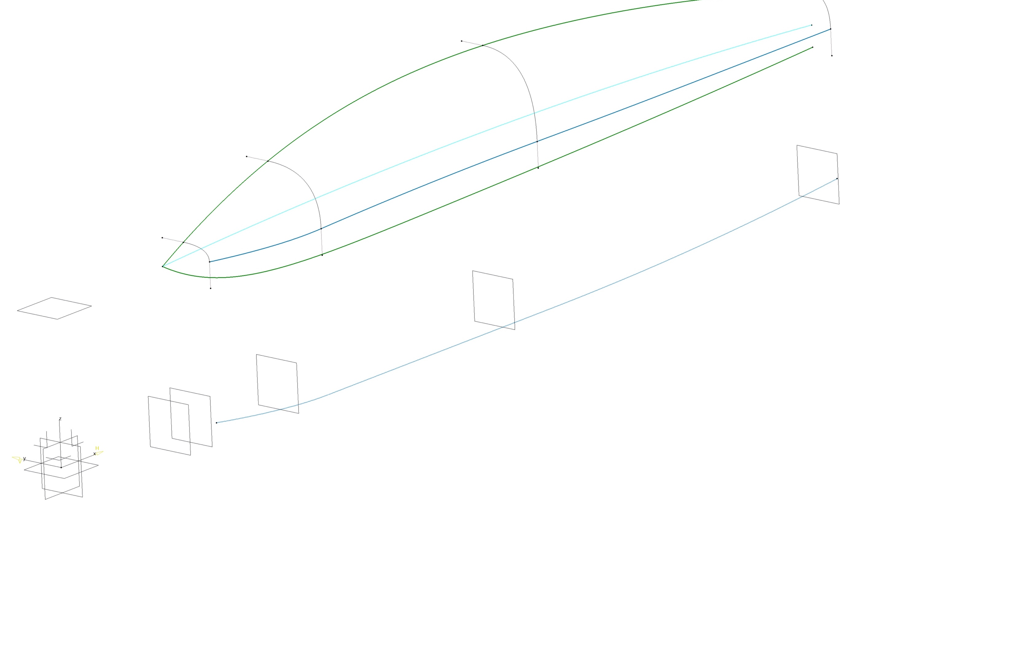
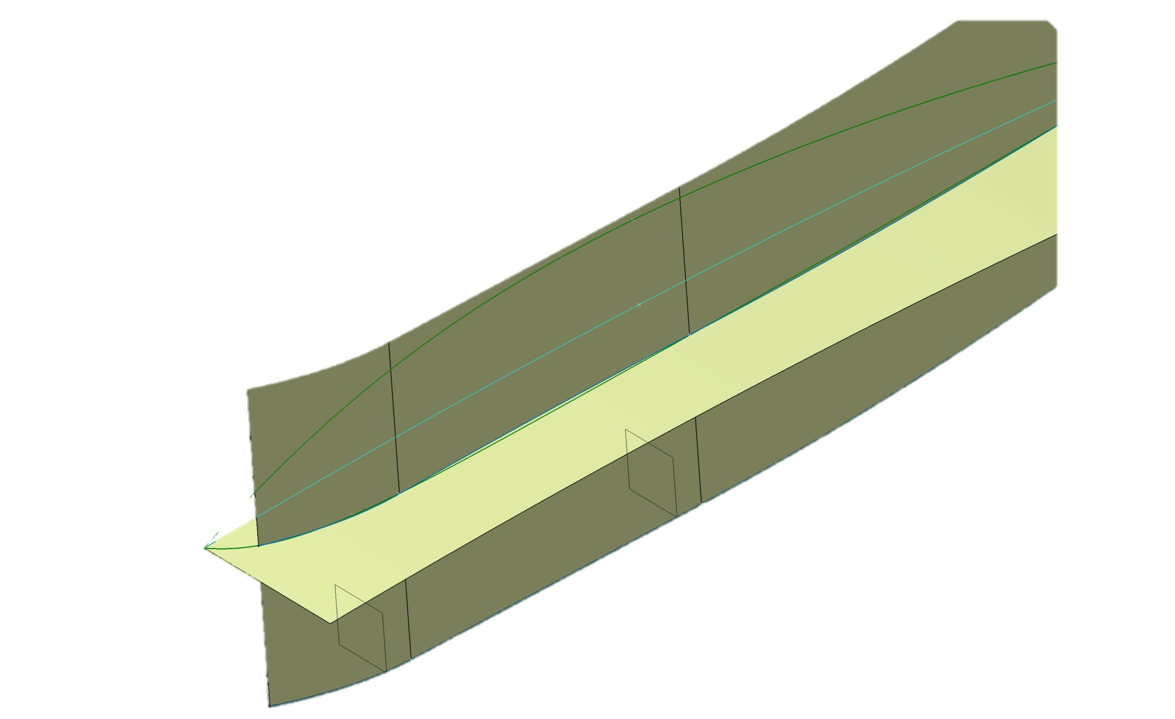
Process for a Body Loft
Create Datums (D1 thru DX) as required to constrain FS and WL curve locations
Create planform curve (C1) on WL0
Create Upper Curve (C2) on BL0
Create Lower Curve (C3) on BL0
Create HMBL construction curve (C4) on BL0
Extrude surface (S1) from C1 in +Z direction
Extrude surface (S2) from C4 in –Y directions
Create HMBL curve (C5) using the intersection of S1 and S2
Create intersection points between FS datums and C2, C3, C5
Optional (may not be need) – add straight lines at points for conic constraints
Create Conics (CN1 thru CNX) as required (only upper conics shown)
Add a multi-section surface using CN1 through CN4 conics, and C2/C5 as guide curves
CN4
CN3
C2
D5
CN2
C4
C5
Straight Lines
DATUMS should be renamed in the CAD system, and should be FSXXX, BLXXX, WLXXX where XXX is the distance from ACS, i.e. FS100
CN1
C3
D4
D3
D1
D2
C1
S2
S1
ACS

Slide 13
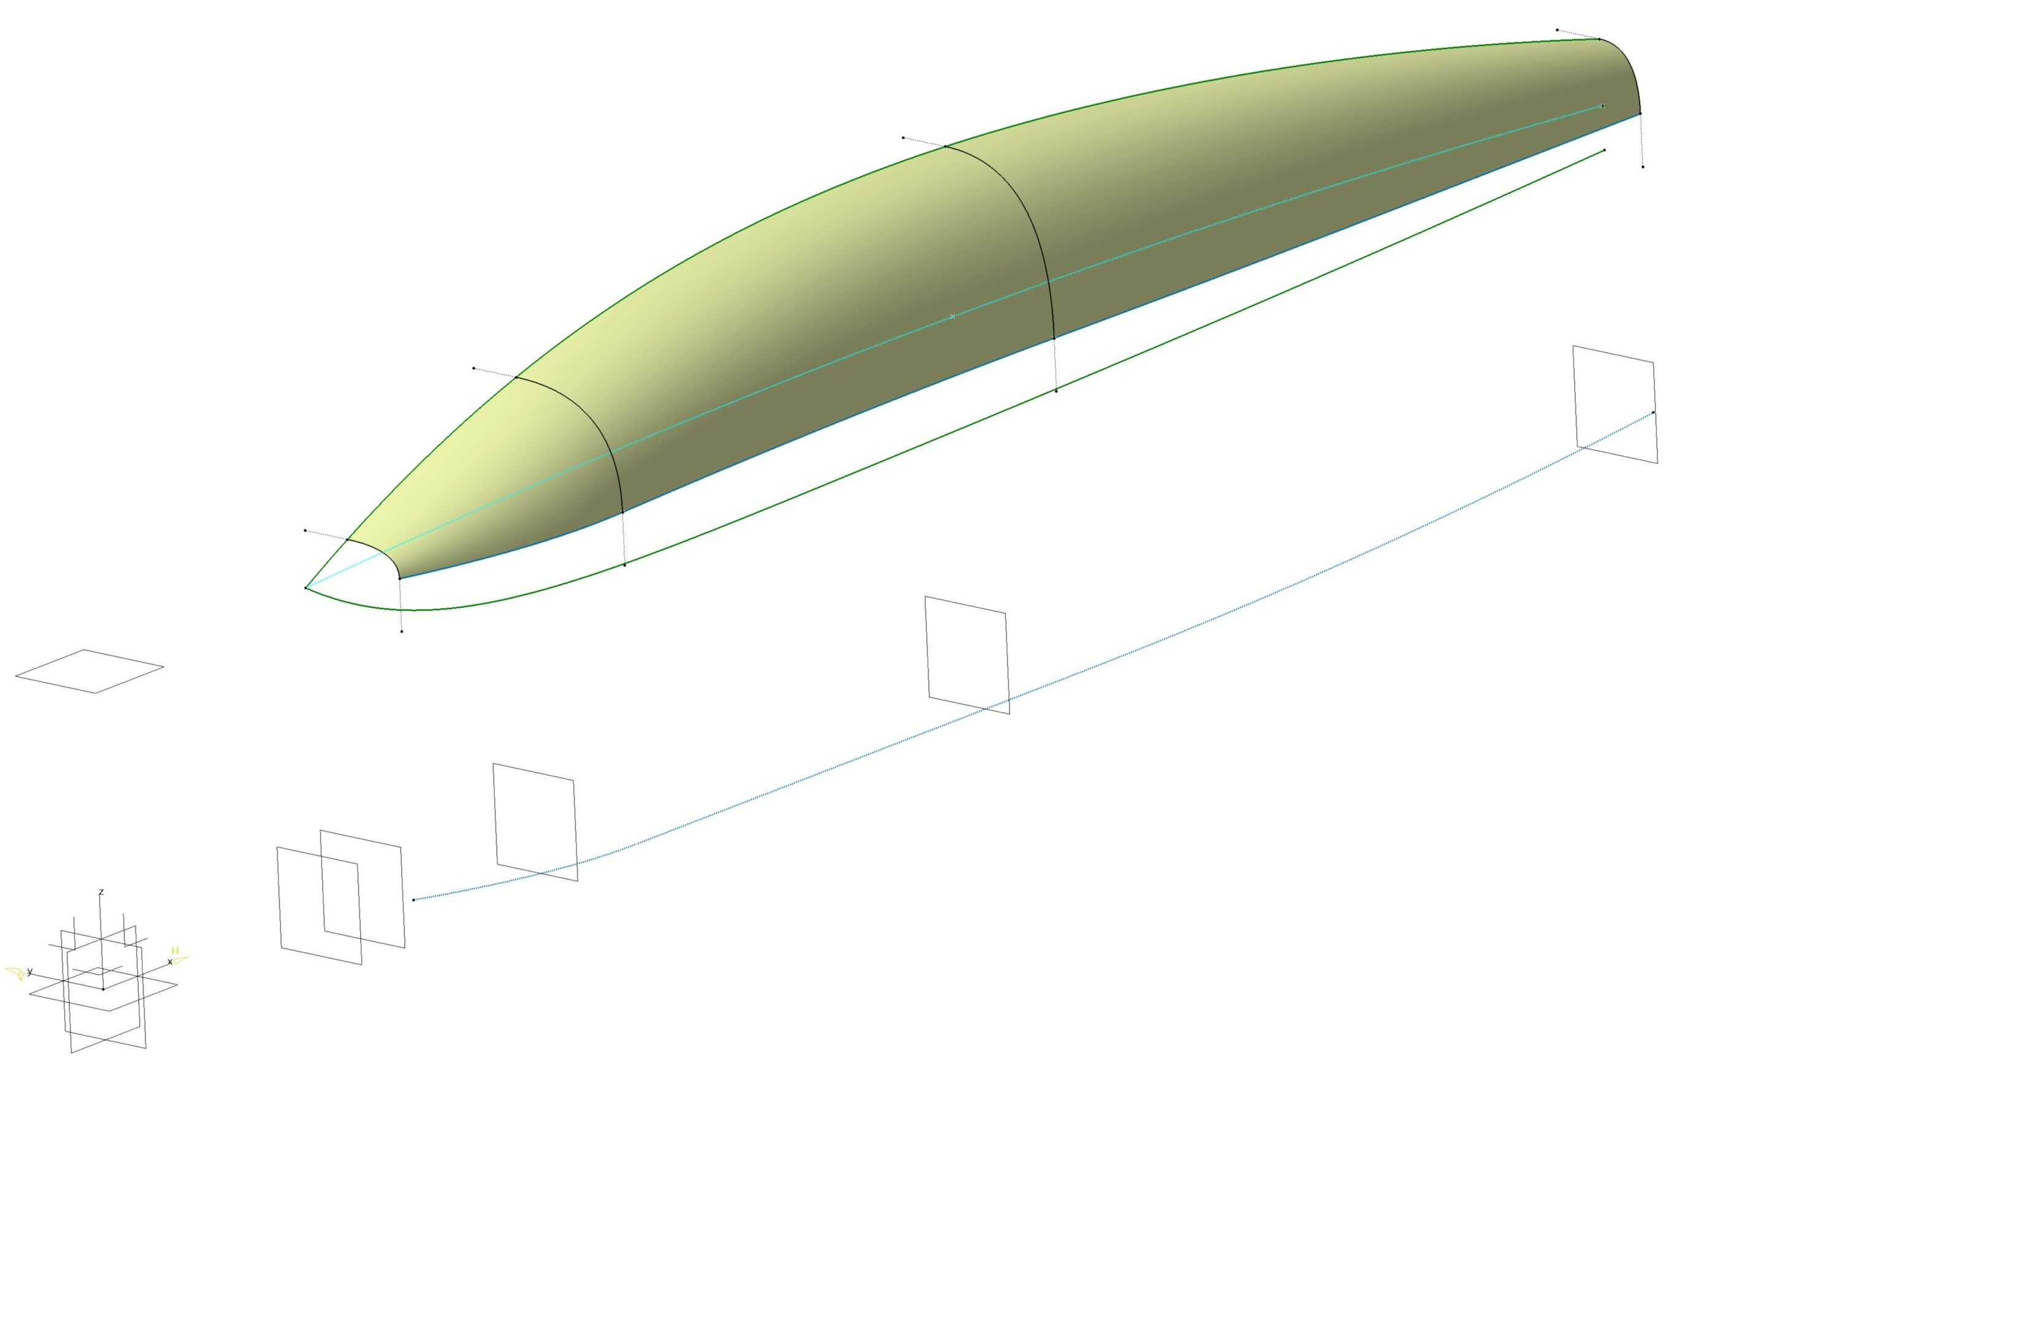
Nose Loft Shaping
Notice the nose and rear surfaces are missing - Do this task last
Construction curve development depends on if you want a bulbous nose, or a sharp nose.
Use conics, splines, fills as required to complete the task
Exercise is left to you

Slide 14
Advanced Topic

Slide 15
Alternate Method using Angled Datums
Create Datums (D1 thru DX) as required to constrain FS and WL curve locations
Create planform curve (C1) on WL0
Create Upper Curve (C2) on BL0
Create Lower Curve (C3) on BL0
Create HMBL construction curve (C4) on BL0
Extrude surface (S1) from C1 in +Z direction
Extrude surface (S2) from C4 in –Y directions
Create HMBL curve (C5) using the intersection of S1 and S2
Using Datums D1 thru DX, create intersect points on C4
Create DD1 thru DDX, datums normal to C4 and through the points on C4
Using DD1 thru DDX, create intersect points on C2, C3, C5
Optional (may not be need) – add straight lines at points for conic constraints
Create Conics (CN1 thru CNX) as required (only upper conics shown)
Add a multi-section surface using CN1 through CN4 conics, and C2/C5 as guide curves
CN4
CN3
C2
D5
CN2
C4
C5
Straight Lines
DATUMS should be renamed in the CAD system, and should be FSXXX, BLXXX, WLXXX where XXX is the distance from ACS, i.e. FS100
CN1
C3
D4
D3
D1
D2
C1
S2
S1
ACS

